Slide 1


Analysis of Fortune 500 Companies of India
A Data-Driven Industry and Financial Performance Study

Slide 2
Methodology & Data Sources
- Data collected from fortuneindia.com list and financial reports
- Key metrics analyzed: Revenue, Profit, RONW, ROCE, Debt-Equity Ratio, Market Share
- Tools used: Python (BeautifulSoup, Pandas, Matplotlib, Seaborn), Excel(to save cleaned and collected data)

Slide 3
Problem Statement
Analyze the financial performance, sectoral distribution, and key profitability metrics of Fortune 500 companies of India to identify trends and factors influencing success.
-Industry-wise performance.
-Market share analysis.
-Workforce and revenue generation, companies with high profits, companies with declined income compared to previous year (2023).
-Profit distribution specific to industry.
-Correlation between d/e ratio and percentage of profit.

Slide 4
Industry-wise Performance
- Number of Companies per Industry
Majority and Minority
- Top industries in terms of average income
- Industries with Profit and Loss

Slide 5
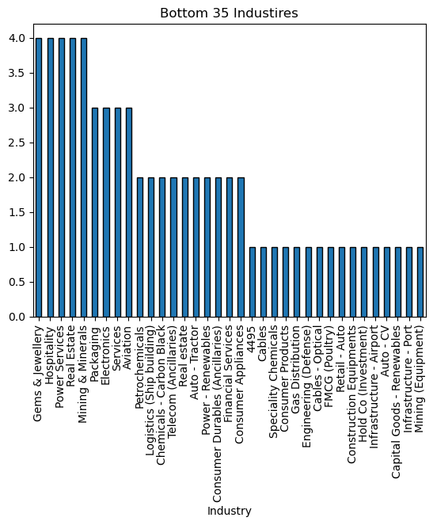
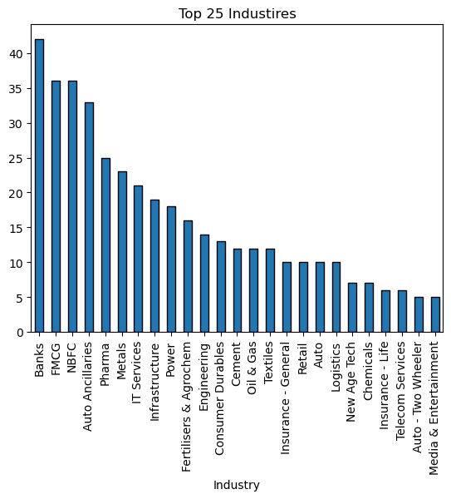
Number of Companies per Industry Majority and Minority

Slide 6
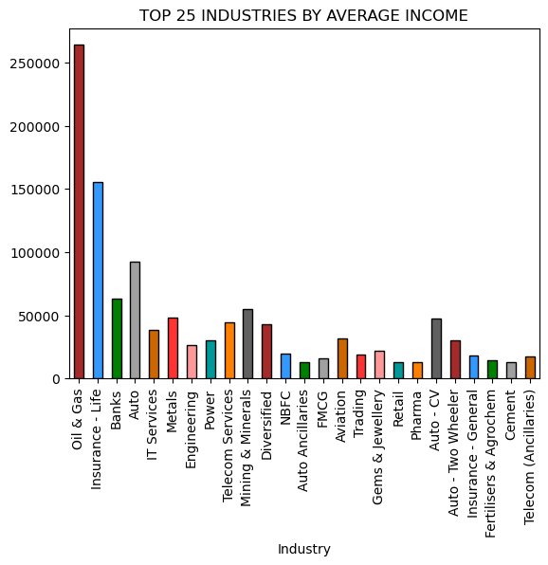
Top Industries in terms of average income
.

Slide 7
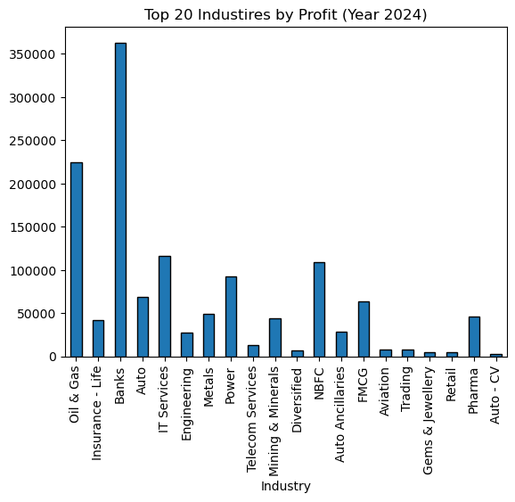
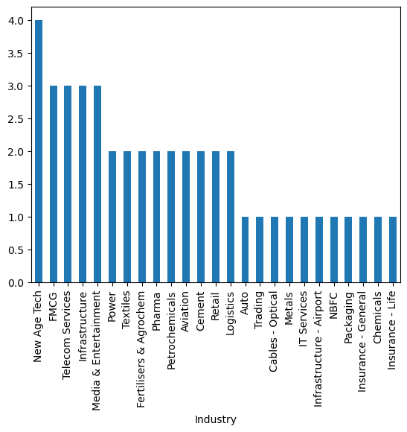
Industries with Profit and Loss
Industries with Profits
Industries with loss

Slide 8
Insights
-Banking sector is the largest contributor among all fortune 500 companies of India.
-The top 4 industries have a count of above 30 while majority of other industries is having a count of below 25
-Industries like Gems & Jewellery, Real Estate, Poultry and other falls under minority, which can be still considered as the developing industries
-Oil & Gas industry is on top in terms of average income while the count of companies in this sector is less than 15, this might be due to the Market Giant in this sector which is Reliance Industry
-Banking Industry is having highest profit around 35,000 crores making followed by Oil & Gas with more than 20,000 crores.(even after having less than 15 companies)
-Few of the industries are common among profit and loss like FMCG, NBFC, Power and more

Slide 9

Market share analysis
Industries Analyzed :
Banks
FMCG
NBFC
Auto Ancillaries
Pharmaceutical

Slide 10
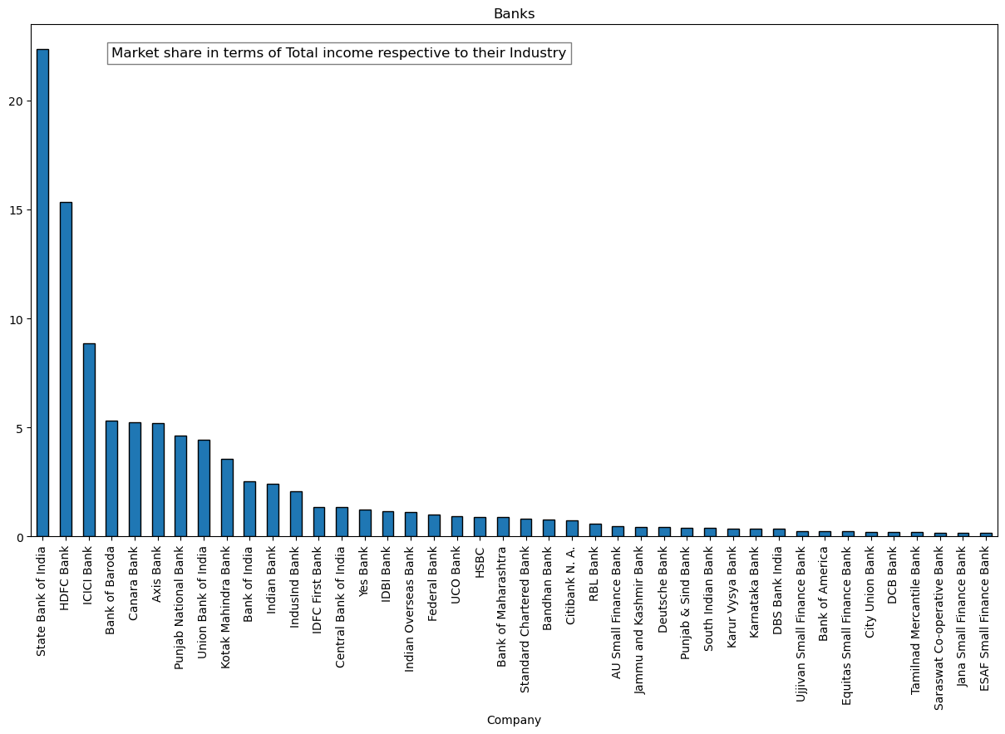
Banks:
-The top 3 banks (SBI, HDFC, ICICI) dominate around 40% of the market share.
-SBI alone holds over 20%, making it the clear leader.
- Majority of the banks are having market share from 0% to 5%.

Slide 11
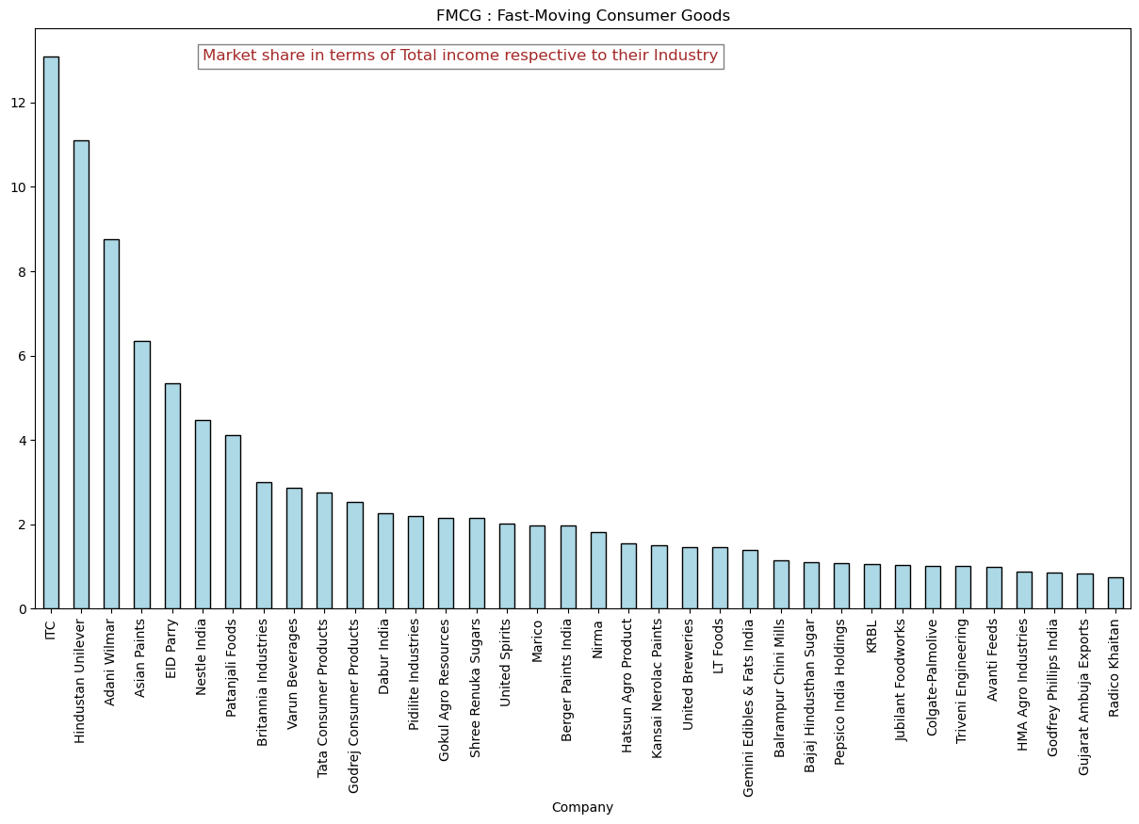
FMCG:
-ITC, Hindustan Unilever, and Adani Wilmar are the key market leaders.
-There are other companies which might be operating in semi-sector of the market with lesser expansion or with fewer states
-The sector is diverse, covering food, beverages, skincare, and more.
-Indicating that this market have a lot of scope and with tough competitors

Slide 12
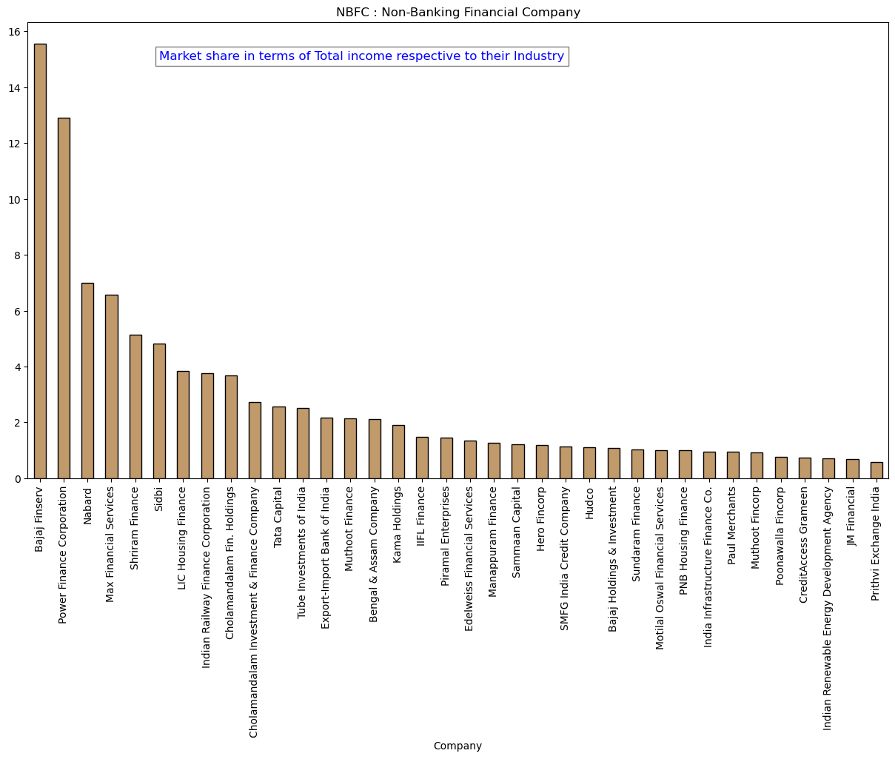
NBFC INDUSTY:
-Bajaj finserv, power finance corporation, nabard, max financial services are the top 4 market leaders.
-They are having market share range from 6% to around 16% and bajaj finserv is the leading among all.
-There few other contenders who are part of same financial company who are targeting different loan and investment services like gold, car and small business loans .
-Consider Bajaj Finserv for stability and leadership.
Keep an eye on NBFCs with niche lending models for high-growth opportunities.

Slide 13
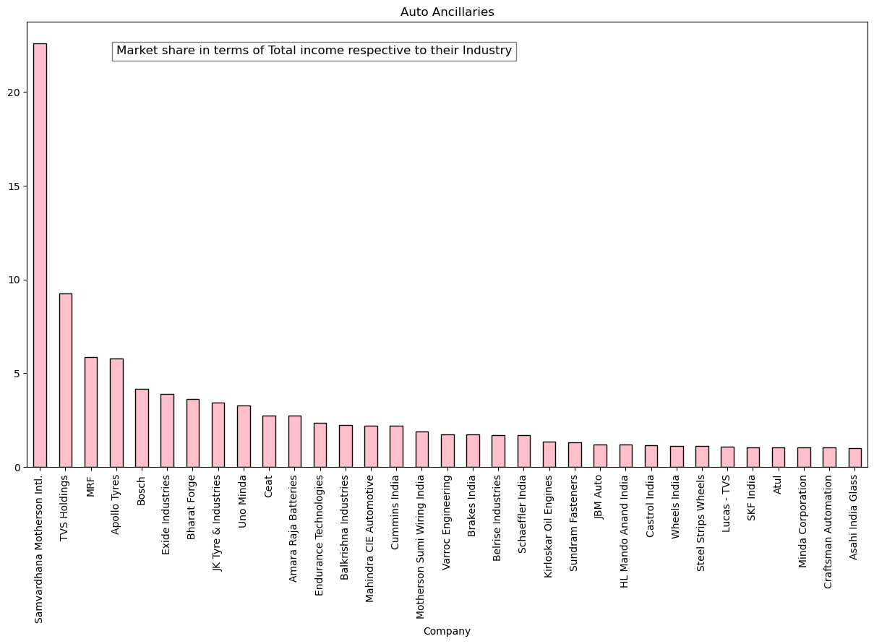
Auto Ancillaries:
-The market leader of this sector is samvardhana motherson intl. With tremendous market share of around 22% and the remaining 78% of the market share is among other companies
-Most of the companies are having less than 10% of Market share.

Slide 14
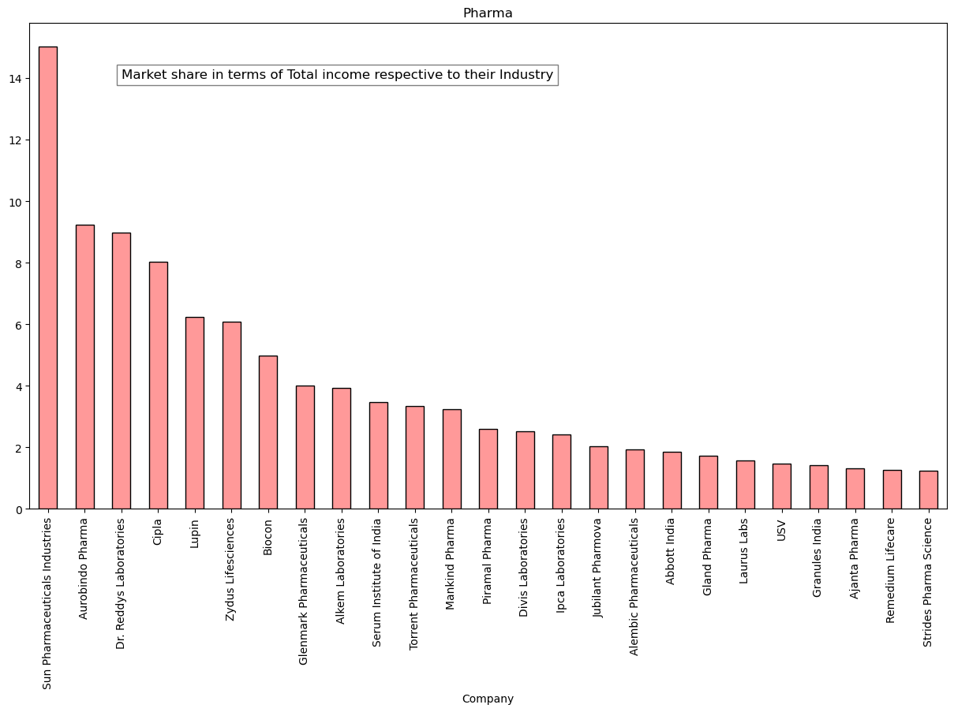
Pharmaceutical Industry:
-Sun pharmaceutical industries is the market leader with more than 14% of the market share but the bar graph suggests that the market is fairly distributed among almost all contenders which means there is more competition.
-This shows the stability in terms of market share.

Slide 15

1)Workforce with revenue generation 2)Companies with high profits 3)Companies with declined income
-It can help us understand the employing power of the organization
-Analyzing companies with profit and also companies with declined income

Slide 16
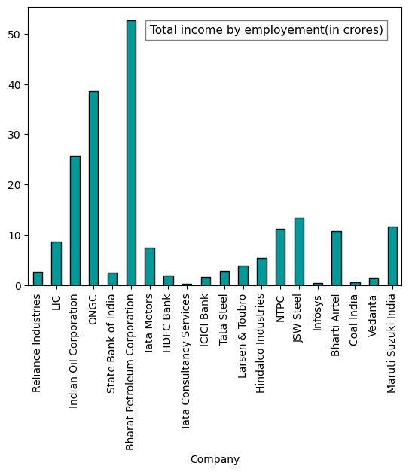
Insights :
-BHARAT PETROLEUM CORPORATION IS THE TOP PROFIT GENERATING COMPANY WITH RESPECT TO EMPLOYMENT
-MOSTLY OIL & GAS INDUSTRY IS HAVING A GOOD PROFIT TO EMPLOYMENT RATIO

Slide 17
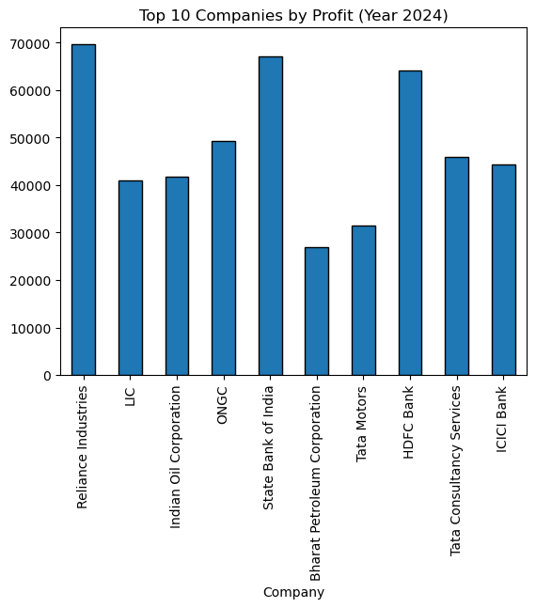
Companies with high generation of profit
-RELIANCE INDUSTIRES HAS HIGHEST PROFITE COMPARED TO OTHER COMPANIES
-AMONG THE TOP 10 COMPANIES 4 OF THEM BELONGS TO OIL & GAS INSDUSTRY
-THE TWO GRAPHS (EMP TO REV & PROFIT) HAVE COMMON COMPANIES.
-WHICH SHOWS THAT THE COMPANIES WITH GOOD PROFITS HAVE GOOD EMPLOYMENT EFFICIANCY

Slide 18
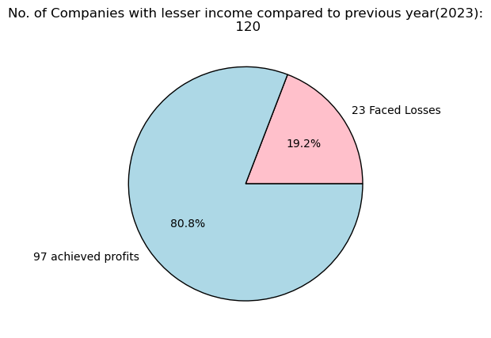
Companies with declined income (compared to previous year 2023)
-Total number of companies with declined income is 120.
-Out of 80.8% (97 companies) of them managed to achieved profit and remaining 19.2% (23 companies) had losses.
-This reveals that decline in total income doesn’t entirely effect generating profits

Slide 19
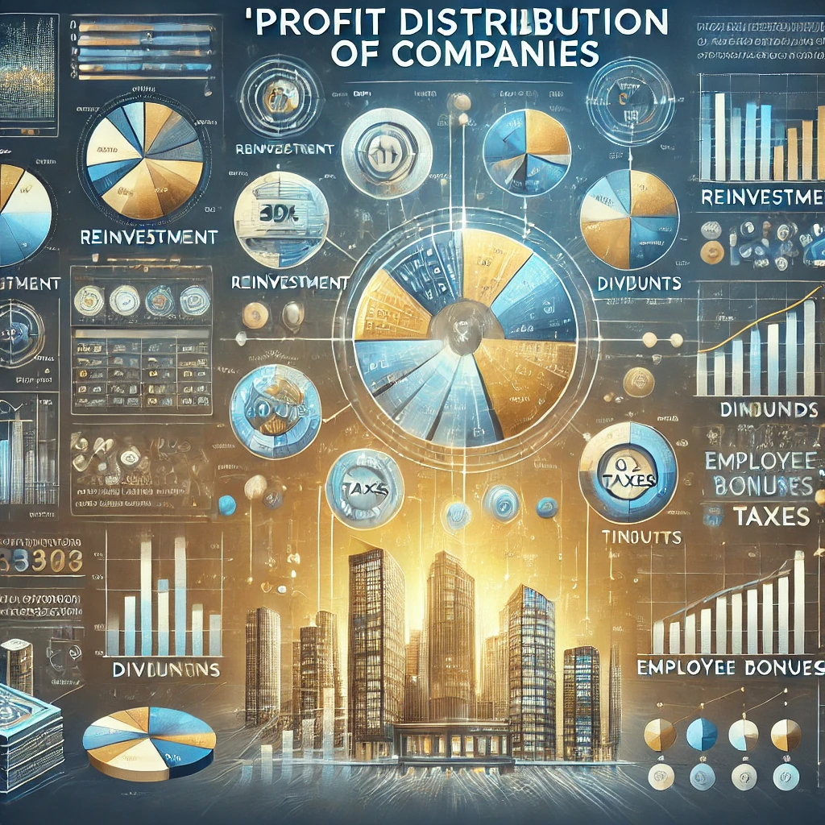
PROFIT DISTRIBUTION OF COMPANIES RESPECTIVE TO THEIR INDUSTRIES
-Profit distribution trends of a few industries
-Profit range of most companies
-Companies pointed at extreme right or left (suggesting massive profits and losses)

Slide 20
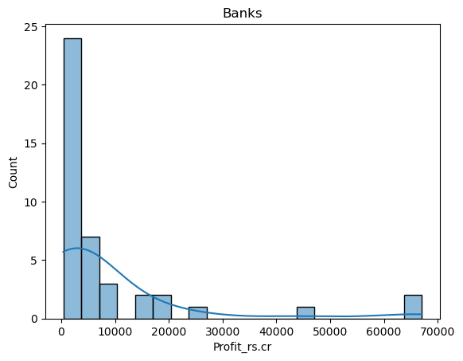
BANKING SECTOR:
-Banks : most of the banks are having profits with in the range of 10,000 crores which is lesser profit range when compare to a few giant contenders, who are having profits more than 30,ooo crores

Slide 21
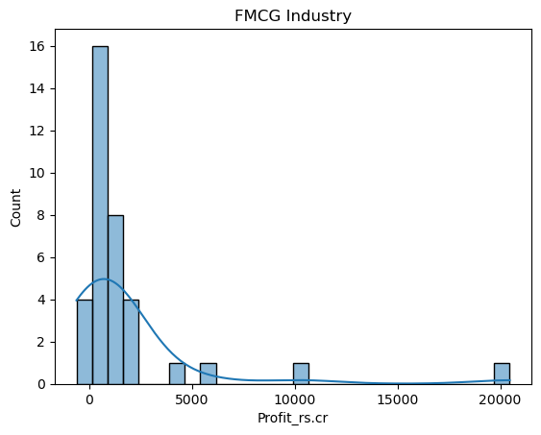
FMCG:
-Most of the companies are having profit within range of r.s 5000 crores, with few are even under loss making.
-There are few companies who earned massive profit , more than 10,000 crores.
- For investments we can consider companies with moderate profits, but there few who are under loss.
- For high growth opportunities we can check the companies with huge profits.

Slide 22
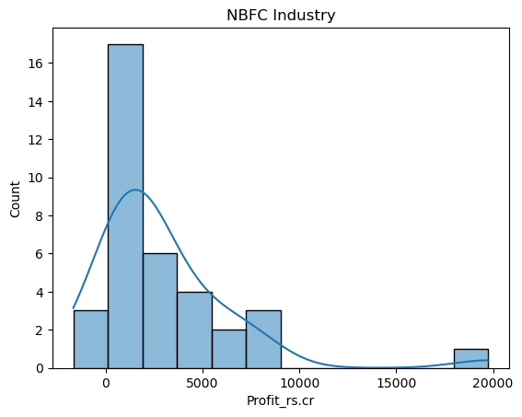
NBFC:NON-BANKING FINANCIAL COMPANY
-Most of the companies are having profits less than 10,000 crores and few companies are under loss making.
-There are companies with profits around 20,000 crores.
- The profit is unevenly distributed with few under loss, investors should look into other factors while investing.

Slide 23
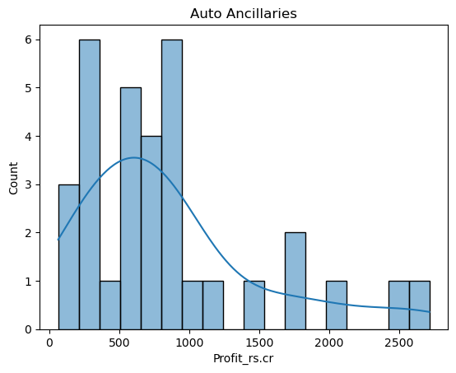
AUTO ANCILLARIES
-A large number of companies are having profits less than 1200 crores, with few are having high profit margins compared to others.
-Almost all companies are generating profits, but some are close to 'break even point(bep)’
- better to invest in companies with stable to high profit margin.

Slide 24
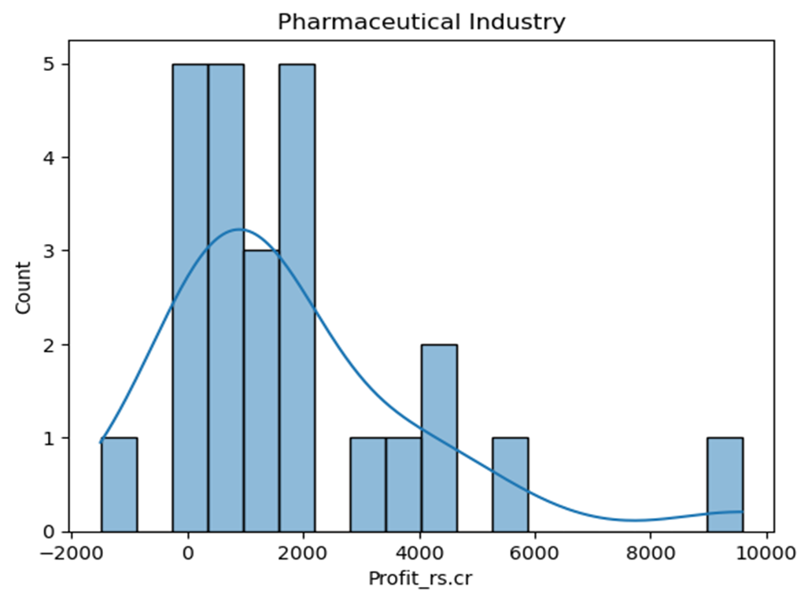
PHARMACEUTICAL INDUSTRY:
-Most of the companies are having moderate profit margin of 2000 crores and few with high as more than 4000 .
- despite of having contenders with huge profits, few companies are facing loss.
-This graph show instability and risk factors.
-Investors should consider companies with moderate to high profit margins to avoid risk

Slide 25

Correlation between d/e ratio and percentage of profit. (Analysis of few industries)
-This will help us to find companies with good profitability when compared with dept-to-equity ratio .

Slide 26
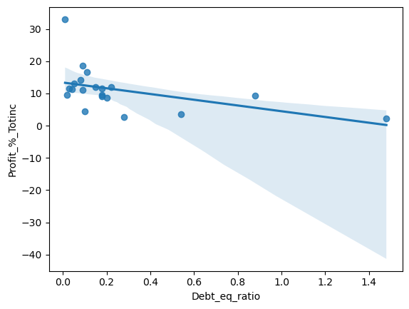
IT Industry:
-Most of the companies are having d/e less than 0.2% and profit from 0.9% to 20%
-Suggesting that generation of profit is relatively high when the companies rely on equity
-This is a positive sign for investing
- Investors should look into companies with less d/e ratio.

Slide 27
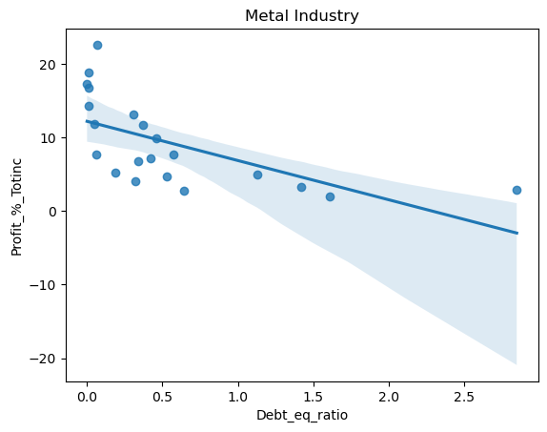
Metal Industry:
-The regression line shows a downward trend, but most companies have a D/E ratio below 1% with profit margins between 0-10%. Some firms achieve high profits despite low D/E. While higher D/E exists, companies still maintain average profitability, indicating industry stability for investment.

Slide 28
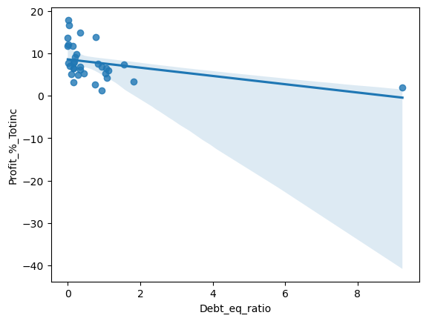
Pharmaceutical Industry:
-The regression line shows a downward trend, but most companies have a D/E ratio below 1% with profit margins between 0-10%. Some firms achieve high profits despite low D/E. While higher D/E exists, companies still maintain average profitability, indicating industry stability for investment.

Slide 29
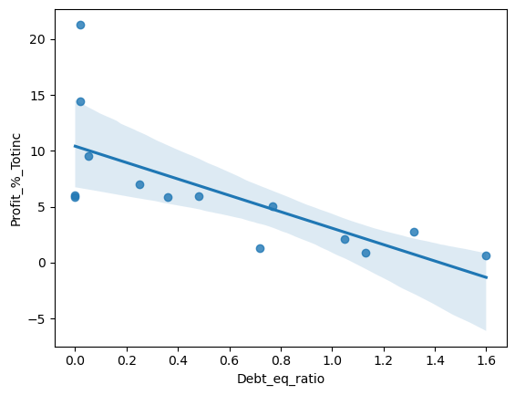
Fertilizers & Agrochemical:
-Even if the data points are scattered still there is a downward regression line
The companies with d/e ratio less than 0.2% are having profit margin of more than 5%
- D/e ratio can moderately harm the profit margins of the companies

Slide 30
Auto Ancillaries:
-There are data points shows that most of the companies are having d/e from 0 to 2 percent
- The companies who are having 0.5 % of d/e are gaining profit percentage more than 10&
-This reveals that the profit margin is being slightly effected by d/e ratio
- Investors should prefer to look into the companies with d/e less than 0.5%
- but companies with moderate d/e and moderate profit margin can be considered

Slide 31
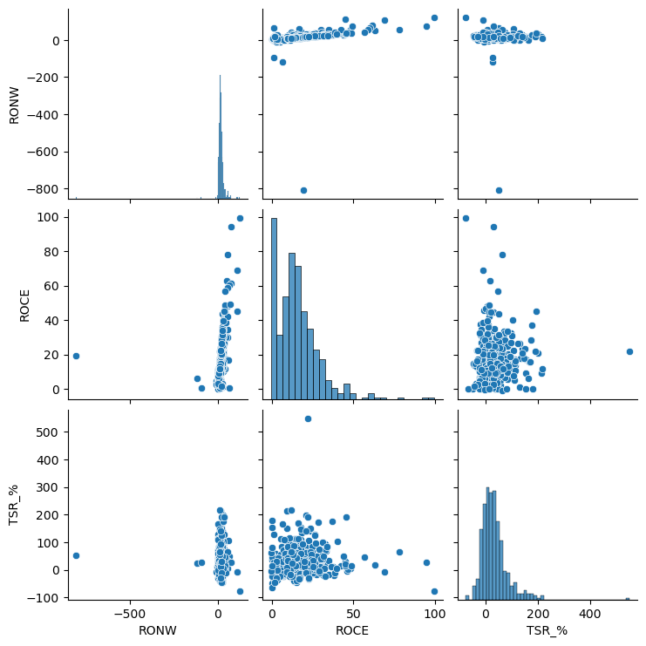
Correlation analysis with ROCE, RONW, TSR

Slide 32
RONW (Return on Net worth): It reflects the profit earning capacity from investment of shareholders
ROCE ( Return on capital employed): It reflects profit earning capacity based on capital used
TSR (Total Shareholder Return): A metric that shows return on investment in stocks

Slide 33
ROCE vs. RONW
ROCE > RONW, the company is effectively using debt to generate returns.
ROCE vs. TSR
ROCE not entirely effect TSR, but it’s a good sign if it is high. Shows capital efficiency.
RONW vs. TSR
High RONW should ideally result in high TSR, but external factors like market confidence, industry trends, and economic conditions can impact stock performance.
KEY POINTS:
ROCE & RONW measure internal profitability, while TSR reflects external market sentiment.
A company with strong fundamentals (high roce & ronw) but low tsr might be undervalued.
Investors should use tsr for stock performance analysis but roce & ronw for long-term business strength.

Slide 34
Key Findings & Recommendations
Look for companies with high ROCE & RONW which is recommended for efficient profitability.
TSR analysis helps in understanding the market perception which reveals undervalued stocks can be good buys.
Banking & NBFC sectors are financially stable despite debt exposure.
FMCG & Pharmaceuticals remain strong due to consumer-driven demand.
Auto Ancillaries sector shows monopolized players, better to invest in market leaders for stability.
Oil & Gas industry have numbers when it comes to average income and profitability

Slide 35
Conclusion
The fortune 500 companies of India reveals diversified industries like banking, FMCG, and NBFCs leading in market share. Profitability remains strong, and despite of having debt concerns, industries show stability. ROCE, RONW, and TSR are key indicators to assess investment opportunities. While some sectors are monopolized (e.g. SBI, sun pharma, bajaj finserv, samavardhana motherson),others.
The whole analysis draws to a conclusion of strategical investment decisions.

